Slide 1
Stereo geometry

Slide 2
Stereo geometry
Stereo geometry, also known as stereo vision or stereo correspondence, is a fundamental concept in computer vision, in which we have two cameras.
In stereo geometry, the two images are referred to as the left image and the right image, and the goal is to find correspondences between the points in these images.
Correspondences are pairs of points that represent the same 3D point in the scene, but they appear in different positions in the left and right images due to the different viewpoints.

Slide 3
Applications of Stereo Geometry
Architecture and Civil Engineering: Architects and civil engineers use stereo geometry to design and analyze structures such as buildings, bridges, and roads. They calculate volumes, surface areas, and spatial relationships of various architectural elements to ensure stability and aesthetic appeal.
Computer-Aided Design (CAD): Stereo geometry is fundamental to CAD software, which is used to create detailed designs of objects and structures. CAD programs use solid modeling techniques based on stereo geometry to represent and manipulate three-dimensional objects.
Manufacturing and Industrial Design: In manufacturing, stereo geometry aids in creating accurate prototypes and models for products. It helps engineers design molds, determine material requirements, and plan production processes.

Slide 4
Computer Graphics and Animation: In video games, movies, and virtual reality applications, stereo geometry is used to model and render 3D objects and scenes. It enables realistic visual effects and simulations by providing the foundation for rendering, lighting, and shading.
Medical Imaging: In medical imaging techniques like MRI and CT scans, stereo geometry is employed to reconstruct three-dimensional images of internal structures in the human body. This helps in diagnosis, treatment planning, and medical research.

Slide 5
Stereo Set-up
X
Epipolar plane
l,l’: Epipolar
x
x’
l
lines
l’
e e’
Camera centers
C’
e, e’: epipoles
C

Slide 6
Epipoles
Epipoles are points in one camera's image plane that correspond to the positions of the other camera's optical center (also known as the camera center) and vice versa.
The epipole is the point in one camera's image plane where all the epipolar lines intersect.
It corresponds to the position of the other camera's optical center.
Similarly, the other camera has its own epipole in its image plane.
The epipole is a geometric invariant that remains the same regardless of the relative motion or orientation of the cameras.

Slide 7
Epiploar Line
Given two cameras observing the same scene from different viewpoints, the epipolar line in one camera's image plane is the line connecting the camera's optical center (center of projection) with a corresponding point in the other camera's image plane.
Epipolar lines help constrain the possible positions of corresponding points in stereo image pairs, making matching more efficient and accurate.

Slide 8
So, let us consider what is meant by stereo setup. In the stereo setup, we have two cameras and in this two cameras, they are specified by their camera centers and their image plane .And scene point X for which you will be taking the images in both this cameras.
So, if we apply the rule of projection here. So, we get the image of this scene point capital X in the first camera, whose camera center is given as C as a say small x. Similarly the second camera given by the camera center C prime forms an image of that same scene point at x prime in its own image plane.
So, you have two images of the same scene point and this is what you will get in a stereo setup.
Now, this particular construct has certain properties geometric properties. What we can see particularly that the point C X C and the if I consider a plane found by C C prime and the scene point X. So, the image points X and x prime, they also lie on the same plane.
There is a from first restriction, also if we draw a line between C and C prime which is called you know for a stereo setup as the base line.
So, that also lies on the same plane; not only that those that line intersects the image planes. Again, there are some images image points in the image plane and in fact, as we can see that one of these intersection point is here which can be interpreted as the image of camera center of the other camera. And the other point is shown here point of intersection of the base line with the other image plane, which we can interpret also as image of camera center of the first camera. So, these two points, these are called as epipoles and they are also lying on the same points.

Slide 9
So, they are denoted here by e and e prime and the line joining e and x which is nothing but intersection of the plane containing all these points X C C dash their image points. So, that intersection with the first image plane, it will be giving you another line say and similarly get two such lines in two image planes because the intersections with respect to the three-dimensional plane formed by same point and camera centers. Now, those two point; those two lines they are called epipolar lines.
But you should note this interesting configuration that all of this you know points and lines, they lie on the same plane and that plane is called epipolar plane with respect to this same point.

Slide 10
Epipolar geometry
Epipolar geometry is a fundamental concept in computer vision and stereo vision that deals with the geometric relationship between two cameras observing the same scene from different viewpoints..
It plays a crucial role in tasks like stereo reconstruction, 3D scene reconstruction, and camera calibration.
Epipolar Constraint: The epipolar constraint states that the corresponding points of a 3D point in one image must lie along the epipolar line in the other image. This constraint significantly reduces the search space for matching points, making stereo correspondence more efficient.

Slide 11
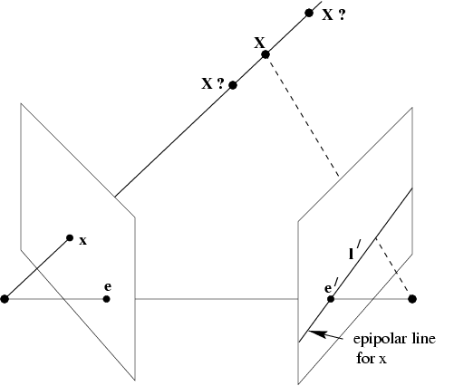
Epipolar geometry
Corresponding point of x in the right image lies on l’.
From Hartley and Zisserman, “Multiple view geometry in computer vision”, Cambridge Univ. Press (2000)

Slide 12
So, if we consider the projection ray formed by the first camera and the image point, then any point lying on that ray is a possible candidate of a same point from which whose image is this X and if we take the image of the scene point by the second camera. So, this image would lie on the epipolar line. So, that is a geometric interpretation.
So, this is a constraint that is imposed by this particular configuration.

Slide 13
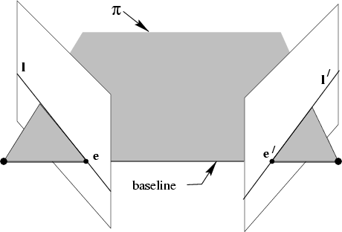
Epipolar geometry
All points on  project on l and l’

Slide 14
So, first camera we will call left camera because from the diagram’s representation the diagram.
So, you will also sometimes refer it as left camera and the second camera, we will refer it as right camera.
Similarly, the epipoles out of this first epipole e is considered the left epipole, that is just the epipole on the reference image plane or first image plan.
So, first camera is considered as a reference camera of the stereo setup and second epipole, it sometimes it is also referred as right epipole that is on the corresponding epipole on the second camera.

Slide 15
You can also interpret epipoles as a vanishing point of camera motion direction.
what is a camera motion direction?
It is a direction of translation of the camera center. So, which is again given by the baseline. So, in that direction as you can see that it is the intersection of that ray with respecting image plane will give you that intercepting point will be always the vanishing point along that direction.

Slide 16
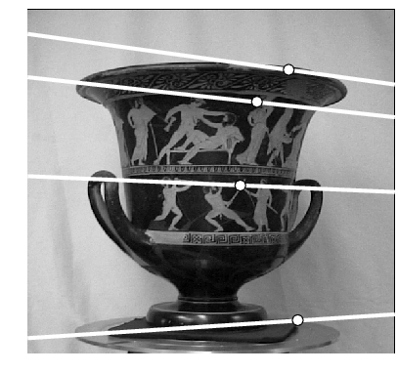
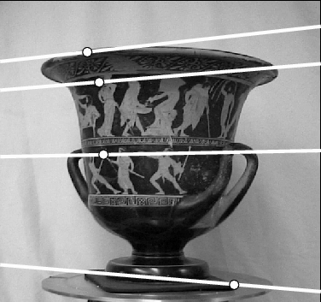
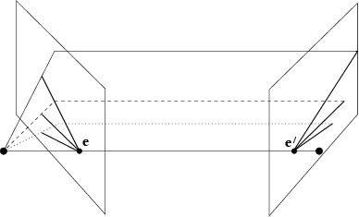
Example: converging cameras
From Hartley and Zisserman, “Multiple view geometry in computer vision”, Cambridge Univ. Press

Slide 17
Also you take a situation, when you know you have simply translation of camera center. There is no rotation of axis.
So, which means your epipolar lines they become parallel so, all epipolar lines they become parallel; parallel to the direction of motion of the image planes or the camera.
So, since know epipolar parallel lines the meet at infinity. So, this epipoles also in the image plane, they are the points which are lying at line at infinity.

Slide 18
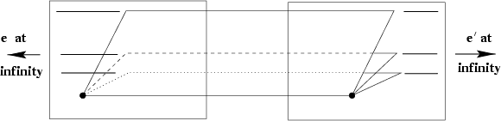
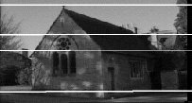
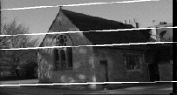
Example: motion parallel with image plane
From Hartley and Zisserman, “Multiple view geometry in computer vision”, Cambridge Univ. Press

Slide 19
Epipolar geometry
Epipoles e,e’
= intersection of baseline with image plane
= projection of projection center in other image
= vanishing point of camera motion direction
An epipolar plane: plane containing baseline (1-D family)
An epipolar line: intersection of epipolar plane with image (always come in corresponding pairs)

Slide 20
Fundamental matrix
fundamental matrix- its task is that it converts an image point to a line which is an epipolar line and sometimes they are called also, this relationship is also called co-relation. This transformation is called co-relation. D.O.F for fundamental matrix is 7.
The fundamental matrix is a 3x3 matrix that encapsulates the epipolar geometry between two cameras. It relates corresponding points in two images through the epipolar constraint. The matrix can be computed using a set of corresponding points and is a key component in stereo vision algorithms.

Slide 21
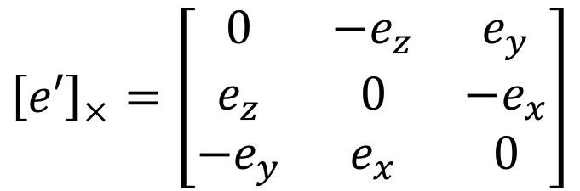
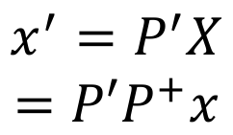
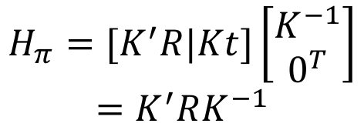

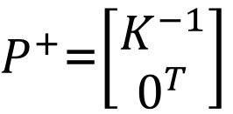
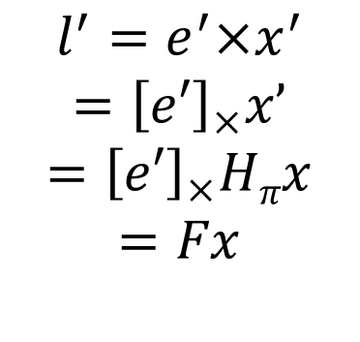

Epipolar Geometry
X
Epipolar plane
For scene points lying on
x
x’
l
l’
plane at infinity.
e
e’
C
C’
P’=K’[R | t]
P=K[I | 0]
F=[e’]_{x}K’RK⁻¹
Coplanar: X, x, x’, C, C’, e, e’, l, l’

Slide 22
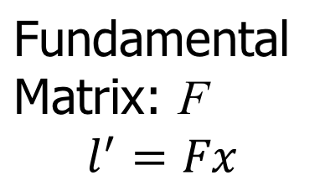
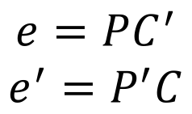


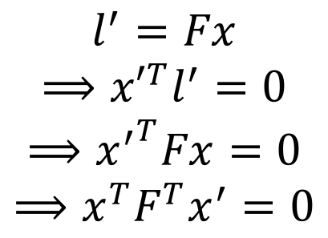
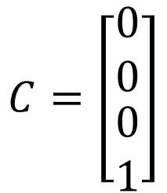
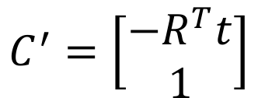
Epipolar Geometry
X
x
x’
l
l’
e’
C
P=K[ I | 0]
C’
e
P’=K’[ R | t]

Slide 23
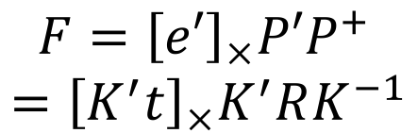

P= K[I | 0] P’= K’ [R | t]
Fundamental and Essential Matrices
Say, P=[I | 0], i.e. K=I
P’=K’ [R | t]=[K’ R | K’ t]=[M | m]
Essential Matrix (E)

Slide 24
Essential Matrix:
It is used for calibrated camera.
Homogeneous matrix, 3x3 matrix

Slide 25
X
P=K[I | 0]
P’=K’ [R | t]
Essential Matrix
x
x’
l
l’
C
e
e’
C’
Stereo geometry for calibrated cameras.
x ’_{c}=K’⁻¹x’
x = K⁻¹x
x’ ^{T}Ex =0
c c
c
Coordinates in calibrated
x’^{T}Fx=0
image planes.
→(K’x ’)^{T}F(Kx )=0
E=K’^{T}FK F=K’^{-T}EK⁻¹
E=[t] R
c c
T T
x
→x’_{c} K’ FKx_{c}=0
→x’ ^{T}(K’^{T}FK)x =0
c
c
Ee_{c}=e’_{c}E=0 Rank: 2 det(E)=0
=K’^{-T} [t] R K⁻¹
6 parameters
x
E
d.o.f.=5

Slide 26
Camera Motion
In computer vision, understanding the motion of a camera is a fundamental task that has applications in various fields such as robotics, autonomous vehicles, surveillance, augmented reality, and more.
Analyzing camera motion involves determining how the camera moves and/or rotates in relation to a scene.
This information is crucial for tasks like 3D reconstruction, object tracking, scene understanding, and navigation.

Slide 27
key concepts related to camera motion in computer vision:
Camera Pose
Camera Motion Types
Camera Calibration
Optical Flow
Feature Tracking
Structure from Motion (SFM)
Visual Odometry
Bundle Adjustment
SLAM (Simultaneous Localization and Mapping)
Egomotion

Slide 28
Camera Pose: The pose of a camera refers to its position and orientation in 3D space. It is typically represented by a transformation matrix that includes the rotation and translation components. The camera pose can be described in various coordinate systems, such as world coordinates, camera coordinates, or a combination of both.
Camera Motion Types:
Translation: This refers to the movement of the camera along a straight path without rotation. It can be described by changes in the camera's position coordinates.
Rotation: Camera rotation involves changes in its orientation without changing its position. It is usually represented using rotation matrices or quaternion representations.
Camera Calibration: Before analyzing camera motion, it's important to calibrate the camera to determine its intrinsic parameters (focal length, principal point, lens distortion, etc.). Calibration is necessary to accurately compute camera motion and depth information from images.

Slide 29
4. Optical Flow: Optical flow is the pattern of apparent motion of objects between consecutive frames in a sequence of images. It can be used to estimate the velocity of points in the image and infer camera motion.
5. Feature Tracking: To estimate camera motion, computer vision systems often track features (distinctive points or patterns) across frames. By analyzing the displacement of these features, the system can estimate camera motion.

Slide 30
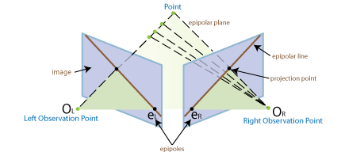
6. Structure from Motion (SFM): SFM is a technique that aims to reconstruct 3D scene structure and camera motion from a sequence of images. It involves triangulating 3D points from their 2D projections in multiple images, which provides both camera poses and scene geometry.

Slide 31
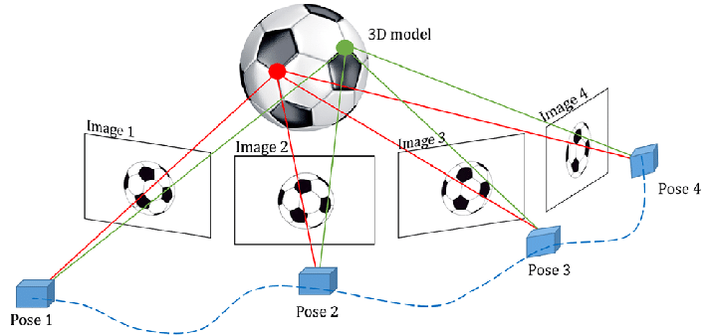
7. Visual Odometry: Visual odometry is the process of estimating the camera's motion by analyzing the changes in the appearance of the scene between consecutive frames. It's particularly useful for applications like robot navigation and drones.
8. Bundle Adjustment: Bundle adjustment is an optimization technique used in SFM and visual odometry. It refines the estimated camera poses and 3D points to minimize the reprojection error, improving the overall accuracy of the reconstruction.

Slide 32
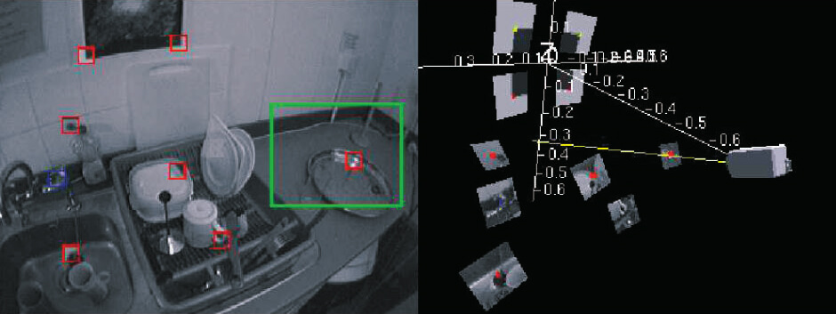
9. SLAM (Simultaneous Localization and Mapping): SLAM combines camera motion estimation with building a map of the environment. It's widely used in robotics to enable vehicles to navigate while simultaneously mapping their surroundings.

Slide 33
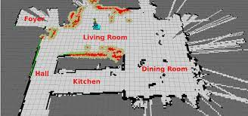

Slide 34

10. Egomotion: Egomotion refers to the motion of the camera with respect to the scene. It's often used to describe the motion of handheld or wearable cameras.

Slide 36
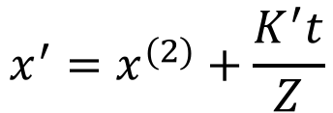
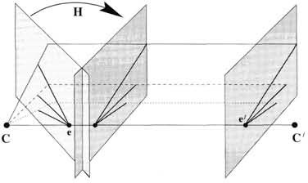

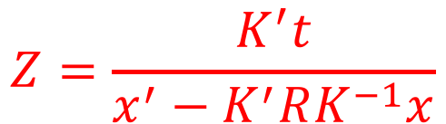
General Motion of Camera
x⁽²⁾ =K’[R|0]X
=K’R[I|0]X
=K’RK⁻¹K[I|0]X
=K’RK⁻¹x
H=K’RK⁻¹
Rotational Homography
||^{l} stereo
_{e}(2) P⁽²⁾⁼K’[R|0]
P=K[I | 0]
P’=K’ [R | t]
From Hartley and Zisserman, “Multiple view geometry in computer vision”, Cambridge Univ. Press (2000)

Slide 37
Normalized 8-point algorithm
The eight-point algorithm is an algorithm used in computer vision to estimate the essential matrix or the fundamental matrix related to a stereo camera pair from a set of corresponding image points.

Slide 38
The 8-Point Algorithm is commonly used in computer vision and photogrammetry to estimate the fundamental matrix from a set of corresponding points in two images. This fundamental matrix encapsulates the geometric relationship between the two views and is crucial for tasks like stereo vision, image rectification, and structure-from-motion.
The "normalized" version of the 8-Point Algorithm typically refers to a variation of the algorithm where the input points are normalized to improve numerical stability and accuracy.

Slide 39
Thank you!

